Slide 1
Correla Ltd
Gender Pay Gap Reporting
for dataset: 2026 GPG (Apr 2025 Data)

Slide 2


This report has been produced for your organisation. It includes all the figures required for Gender Pay Reporting under the Employment Equality Act 1998 (Section 20A) (Gender Pay Gap Information) Regulations 2022.
It also provides a detailed analysis of all your datapoints mapped in the Gapsquare app. This allows your company to break down your organization-wide metrics into smaller groups of employees - for example, you could look at employees by age, job level, business unit, or any other custom label.

Slide 3
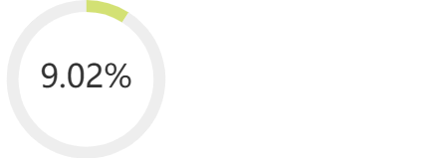
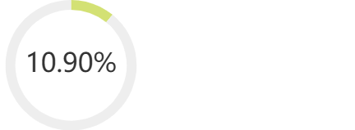
Headline Figures
Hourly remuneration
Women's mean hourly rate is 9.02% less
Mean pay per hour for men: 31.64
Mean pay per hour for women: 28.79
Difference in pay: 2.85
Women's median hourly rate is 10.90% less
Median pay per hour for men: 29.07
Median pay per hour for women: 25.90
Difference in pay: 3.17

Slide 4
Headline Figures
Quartiles
Bonus
Group | Mean Pay Males | Mean Pay Females | Pay Gap (mean) | Pay Gap (median) | Percentage of Males | Percentage of Females | Contribution to Pay Gap
Lower quartile | 16.80 | 16.56 | 1.38% | 0.17% | 39.56% | 60.44% | -7.54%
Lower middle quartile | 24.81 | 24.45 | 1.46% | 6.11% | 58.24% | 41.76% | 3.51%
Upper middle quartile | 31.94 | 30.96 | 3.06% | 1.9% | 54.95% | 45.05% | 1.60%
Upper quartile | 46.84 | 51.45 | -9.84% | 2.96% | 63.74% | 36.26% | 11.45%
Women's mean bonus pay is 13.20% less
Women's median bonus pay is 22.69% less
Proportion of women receiving bonus: 76.05%
Proportion of men receiving bonus: 72.59%

Slide 5

Pay

Slide 6


Hourly remuneration
Women's mean hourly rate is 9.02% less
Mean pay per hour for men: 31.64
Mean pay per hour for women: 28.79
Difference in pay: 2.85
Women's median hourly rate is: 10.90% less
Median pay per hour for men: 29.07
Median pay per hour for women: 25.90
Difference in pay: 3.17

Slide 7
Detailed Report Analysis By Quartiles
Group | Mean Pay Males | Mean Pay Females | Pay Gap (mean) | Pay Gap (median) | Percentage of Males | Percentage of Females | Contribution to Pay Gap
Lower quartile | 16.80 | 16.56 | 1.38% | 0.17% | 39.56% | 60.44% | -7.54%
Lower middle quartile | 24.81 | 24.45 | 1.46% | 6.11% | 58.24% | 41.76% | 3.51%
Upper middle quartile | 31.94 | 30.96 | 3.06% | 1.9% | 54.95% | 45.05% | 1.60%
Upper quartile | 46.84 | 51.45 | -9.84% | 2.96% | 63.74% | 36.26% | 11.45%

Slide 8
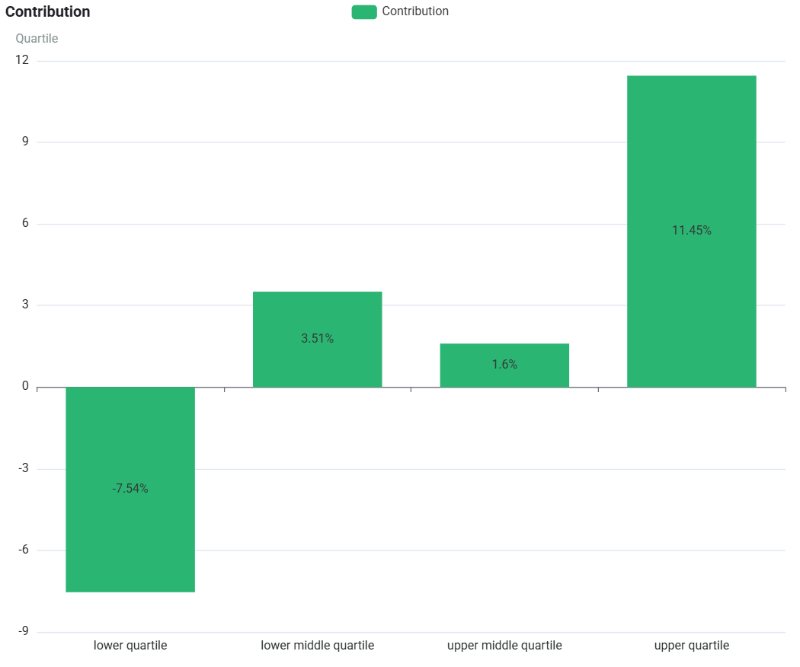
The Contribution section shows how a given sub-category (i.e. Quartile) contributes in percentage points towards your mean pay gap.
Contribution of Each Quartile to the Pay Gap

Slide 9
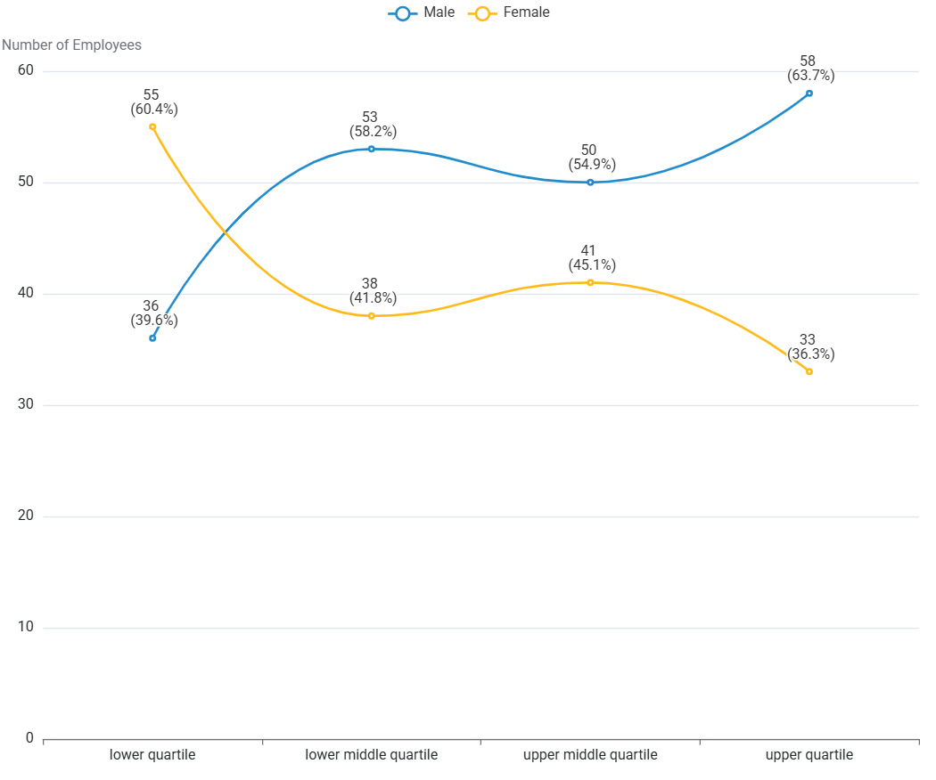
This graph shows the data broken down into 4 equally sized groups ranging from the lowest to the highest paid employees. This graph shows the difference in the actual numbers of employees within the separate pay quartiles.
Workforce Representation by Quartiles

Slide 10
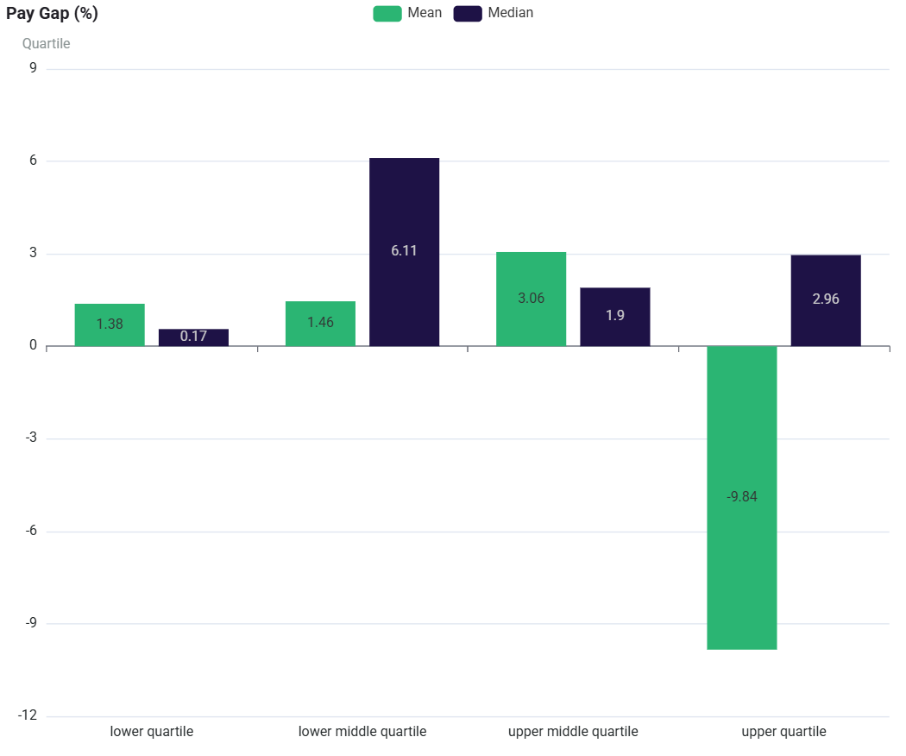
Each Quartile has its own separate pay gap, comparing them shows what levels of pay present the key imbalances and breaks down your organisation’s overall pay gap.
Pay Gaps by Quartiles

Slide 11
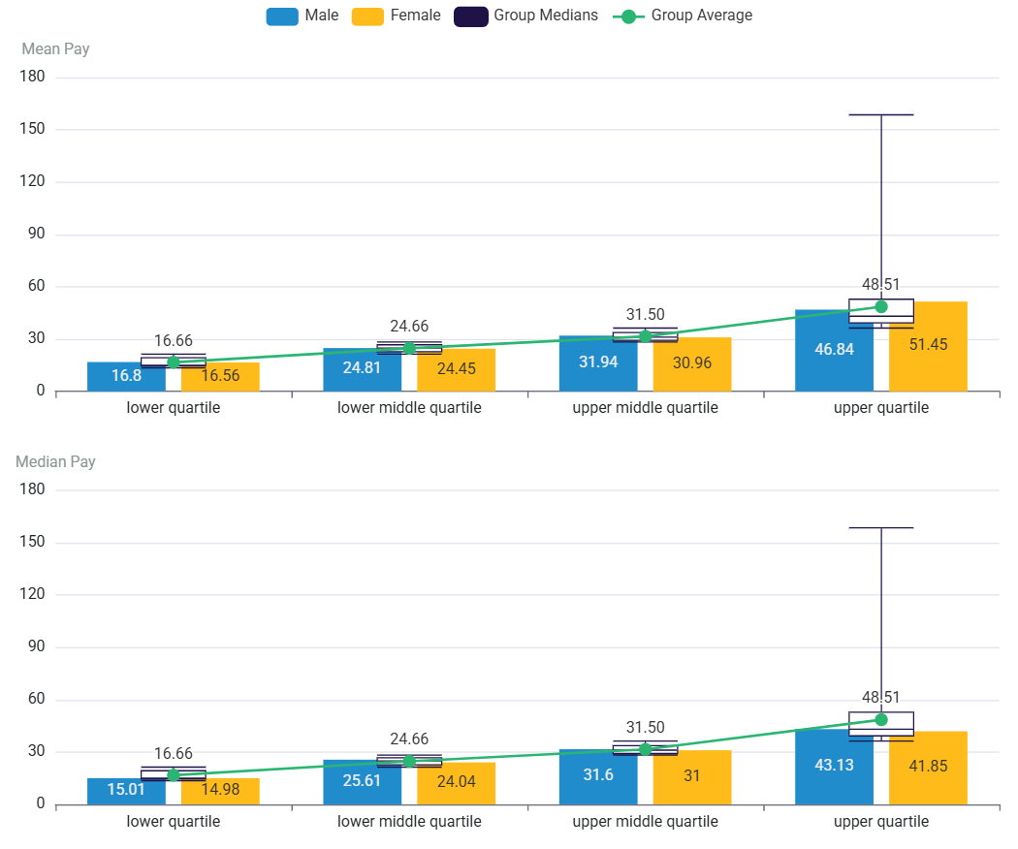
This chart shows you the pay ranges that provide the averages of Mean and Median for comparison.
Pay Ranges by Quartiles

Slide 12
Bonus

Slide 13
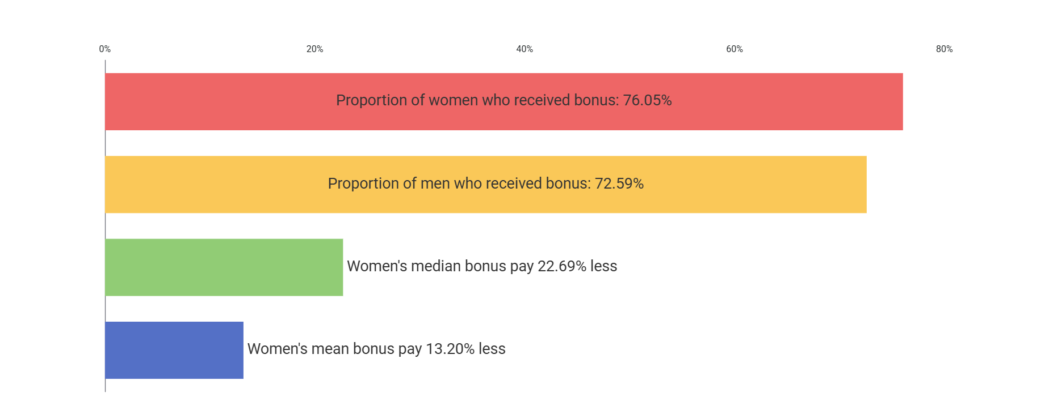
Bonus metrics

Slide 14
Detailed Bonus Analysis By Quartiles
Group | Mean Bonus Pay Males | Mean Bonus Pay Females | Bonus Pay Gap (mean) | Bonus Pay Gap (median) | Percentage of Males | Percentage of Females | Contribution to Bonus Pay Gap
Lower quartile | 927.13 | 784.74 | 15.36% | 17.4% | 45.59% | 54.41% | -0.49%
Lower middle quartile | 2219.55 | 2305.80 | -3.89% | 2.58% | 49.25% | 50.75% | -1.86%
Upper middle quartile | 4447.46 | 4487.57 | -0.9% | -0.1% | 54.41% | 45.59% | 0.98%
Upper quartile | 12846.65 | 14993.87 | -16.71% | 1.64% | 62.69% | 37.31% | 14.57%

Slide 15
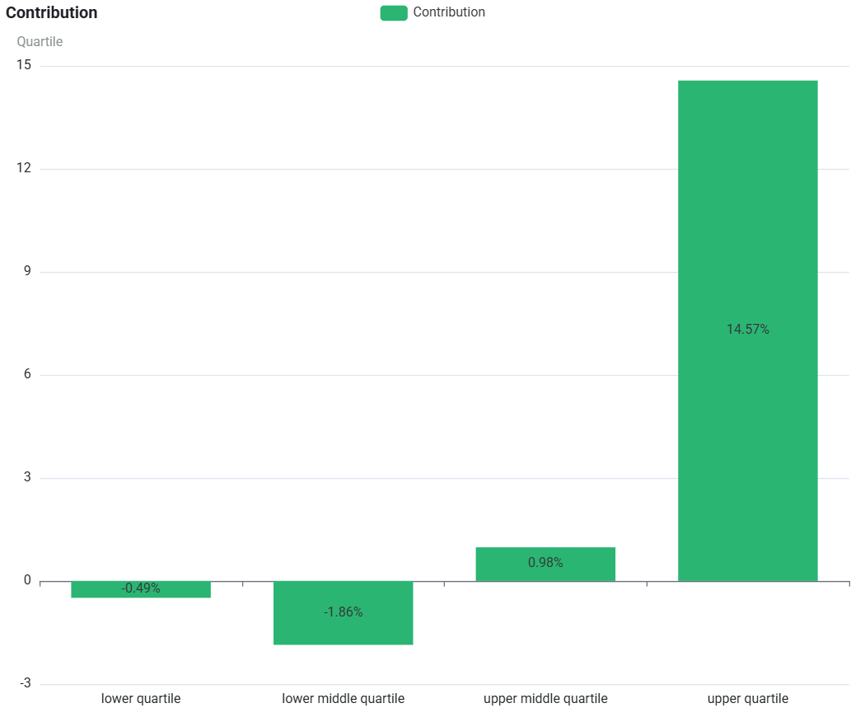
The Contribution section shows how a given sub-category (i.e. Quartile) contributes in percentage points towards your mean bonus pay gap.
Contribution of Each Quartile to the Bonus Gap

Slide 16
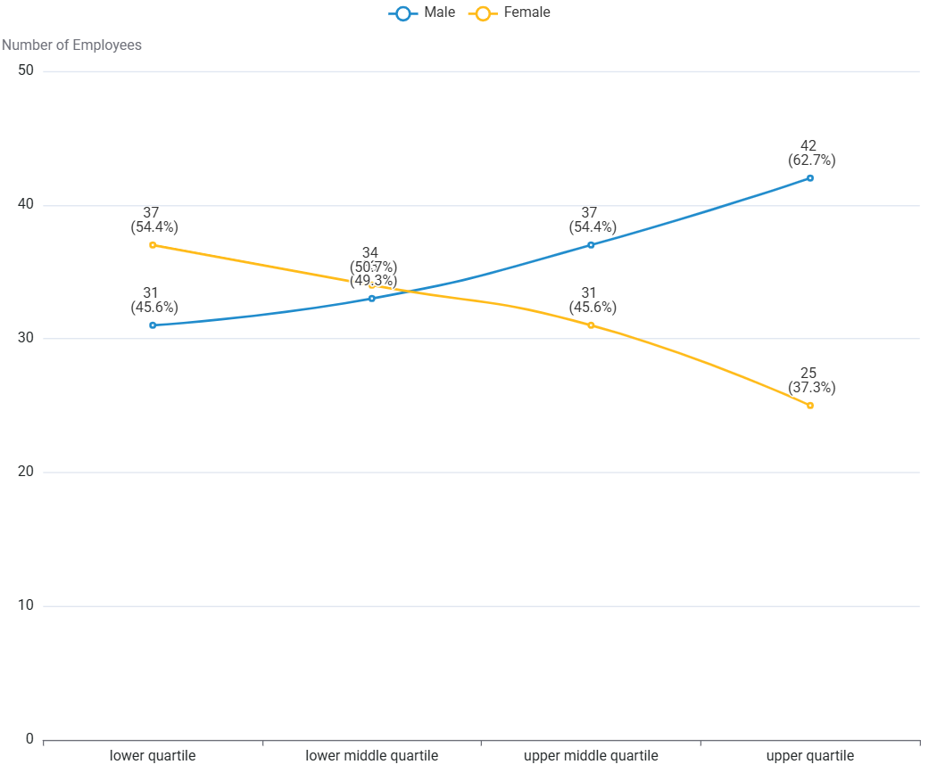
This graph shows the data broken down into 4 equally sized groups ranging from the lowest to the highest paid employees. This graph shows the difference in the actual numbers of employees within the separate bonus pay quartiles.
Bonus Workforce Representation by Quartiles

Slide 17
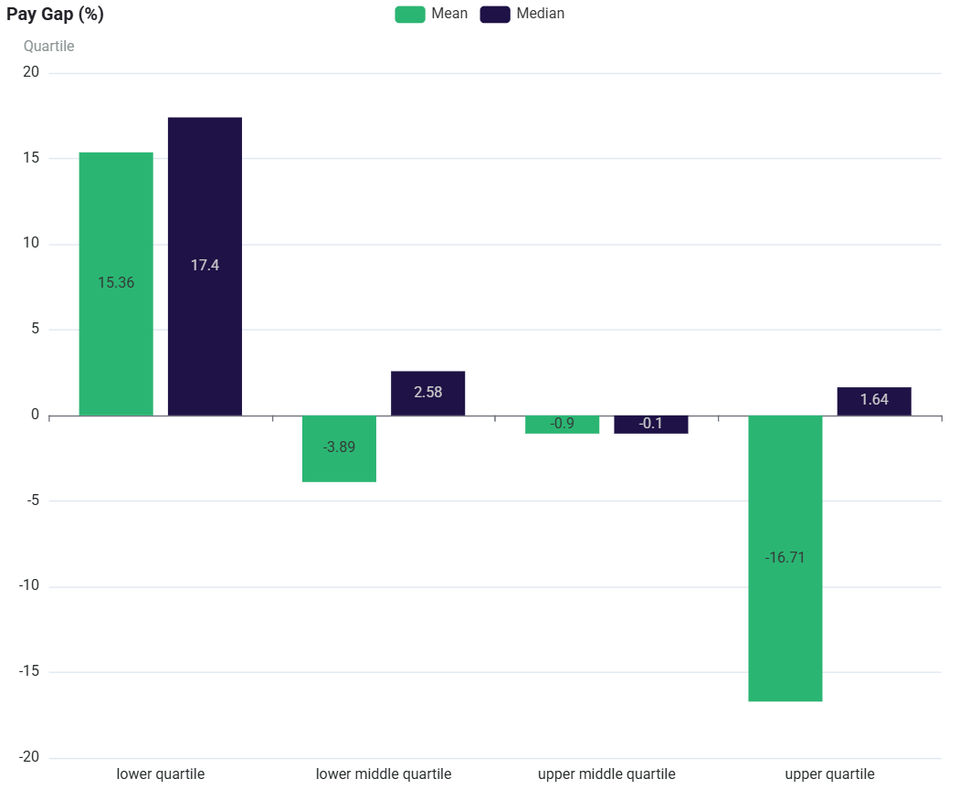
Each Quartile has its own separate bonus pay gap, comparing them shows what levels of bonus pay present the key imbalances and breaks down your organisation’s overall bonus pay gap.
Bonus Gaps by Quartiles

Slide 18
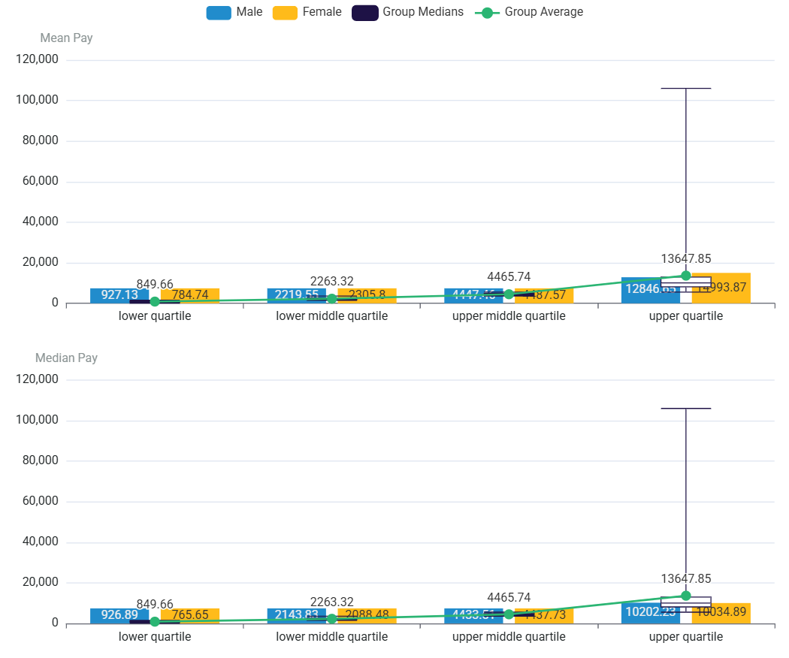
This chart shows you the bonus pay ranges that provide the averages of Mean and Median for comparison.
Bonus Ranges by Quartiles

Slide 19

Glossary of terms
Group:
The name of the groups is taken from your data, using the same terms you have mapped in the Pay Equity Analytics app.
Mean Pay Gap:
The raw difference between men's average pay and women's average pay, usually expressed as a percentage. This can be affected by outliers.
Median Pay Gap:
The difference in pay between the middle-paid man and middle-paid woman in your organisation, usually expressed as a percentage. This is less affected by outliers.
Quartile:
A division of your entire organisation into four groups of equal numbers, starting from the lowest-paid group (lower quartile) to your highest-paid group (upper quartile).
Contribution to Pay Gap:
The number of percentage points a group contributes to your overall mean pay gap, whereby summing all your contributions per group will give you the mean pay gap. Using this, you will see which group contributes most to your organisation's pay gap.

Slide 20

Our commitment to Inclusion and Diversity
At Correla, we want to leverage diversity by helping our colleagues to create an environment where they feel heard and supported to perform at their best.
We strive to create a diverse and inclusive workplace, where people can succeed regardless of their gender, sexual orientation, gender identity and expression, marital or civil partner status, race, religion or belief, colour, nationality, ethnic or national origin, disability, age or pregnancy. We know that if people can be themselves at work, they’ll be happier, more motivated and creative, and Correla will be a better organisation as a result.
Our people are the most valuable asset we have. We recognise the benefits of having talented people from a range of backgrounds, diverse groups and cultures who bring different perspectives, life experiences and diversity of thinking to our business.
Our aim is to attract and retain the very best diverse talent to help create an exciting, innovative and successful business that enables us to deliver an exceptional experience for our customers but also provide rewarding careers for our people.

Slide 21
Correla’s Wellbeing and benefits
Supporting retention, progression and equitable outcomes for all colleagues
Retention & Career Continuity
Flexible Working
Flexible, outcome-focused working supports career sustainability
Enables retention across different life stages, particularly for women
Parent & Kinship Leave
Inclusive policies covering all family types (birth, adoption, fostering, surrogacy and guardianship)
Supports smooth transitions in and out of work, reducing career disruption
Carers Support
Paid leave and practical support for carers
Enables individuals to balance work and caring responsibilities
Buddy programme for returning parents
Connects people with others who have been through similar transitions.
Improves confidence and reintegration.
Wellbeing & Support
Wellbeing
Focus on mental, physical and financial wellbeing
Data-driven approach to continuously improve support
Mental Health First Aiders
Trained colleagues providing early support and signposting
Promotes a culture of openness and early intervention
Access & Fair Opportunity
Recruitment Charter
Fair, ethical and consistent hiring with a focus on diverse skills, backgrounds and thinking
Strong candidate experience to attract and secure diverse talent
Our approach to wellbeing and benefits is designed to enable high performance while supporting colleagues through key life and career moments. This helps to reduce barriers that contribute to the gender pay gap.

Slide 22










Correla’s Awards, Accreditations and Commitments
Our commitment to reducing the gender pay gap is reflected in our independent recognition and in the commitments we make to support equitable outcomes and remove barriers to progression.

Slide 23
Thank you

